Slide 1
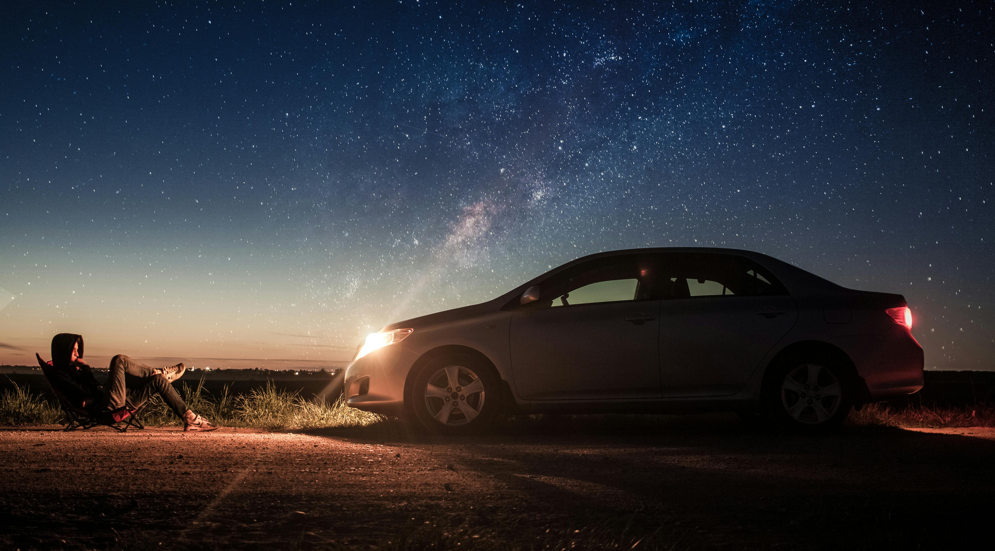
Design Thinking And Innovation
Team 23 - Zenoura
By, Monic Auditya A. Monish D.Y.
Kamalesh P.

Slide 2

E
xplore
ase
The Super App for Smarter, More Enjoyable Travel!

Slide 3

Problem Statement
In our current world travel planning is always associated with disorganized, time-wasting nightmare afflicted with broken platforms, bland suggestions, ugly routes, biased cancellations, unorganized group organization, tiresome cost management, and insufficient real-time support. This creates frustration, economic loss, lost opportunities, and destroyed experiences. Creating smooth and hassle-free travel is almost impossible in this current world

Slide 4

Abstract
ExploreEase is a super app that simplifies travel by combining trip planning with transportation and hotel reservations. It uses AI for smarter recommendations of places based on the trip members' common tastes, prioritizing the spots common to all, and narrowing down to individual preferences. It also allows them to customize and try new destinations based on trip type.
The unique feature of this super app allows users to select routes based on budget efficiency, time efficiency, or enjoyable routes that have attractive places between them, ensuring customer satisfaction with tailored travel plans. It also ensures a fair trip cancellation facility, where if anyone leaves the trip after payment, a poll-based decision is made for a refund or to split that amount with other travellers, which can be disabled if not needed. This prevents the voluntary cancellation of plans by the members.
ExploreEase also includes a chat feature to create groups and discuss ideas. You can post destination details and hotel photos in chats, talk about how you're traveling there, and share new photos on social media so your friends will go there as well. Having an expense tracker to maintain the travel logs is useful for keeping an eye on trip budgets and enjoyment. Other features like ongoing notifications and emergency services are also included. Overall, we can say that ExploreEase ensures an enjoyable travel experience with ease.

Slide 5
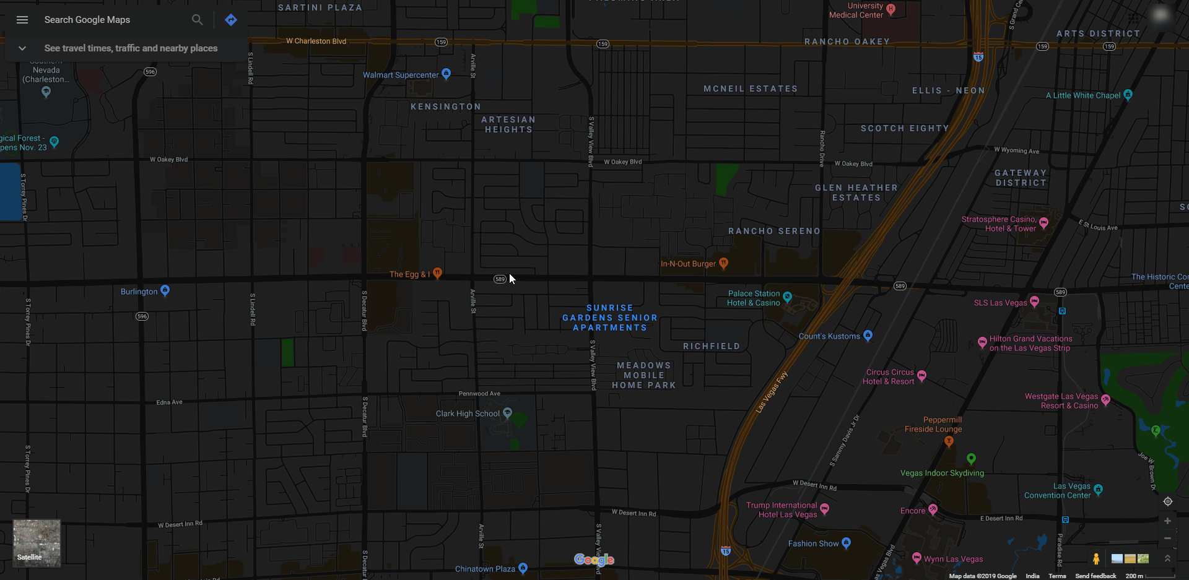









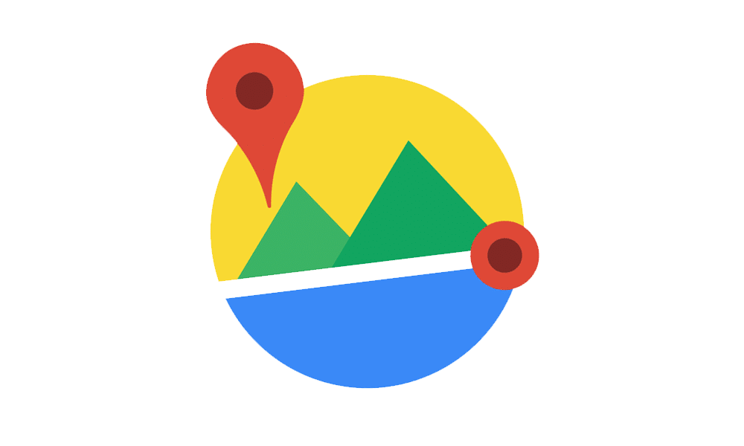
Tech Stack
Databases
PostgreSQL, MongoDB, Neo4J
Frond End
React Native
Maps
Open Street Map
Algorithms
AI/ML, DL
Back End NodeJS
API
Google Places API

Slide 6
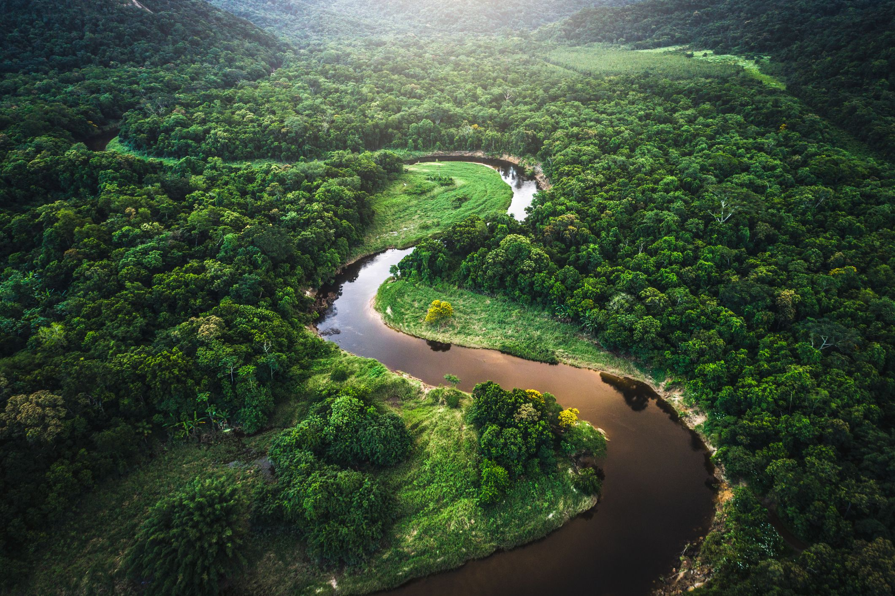
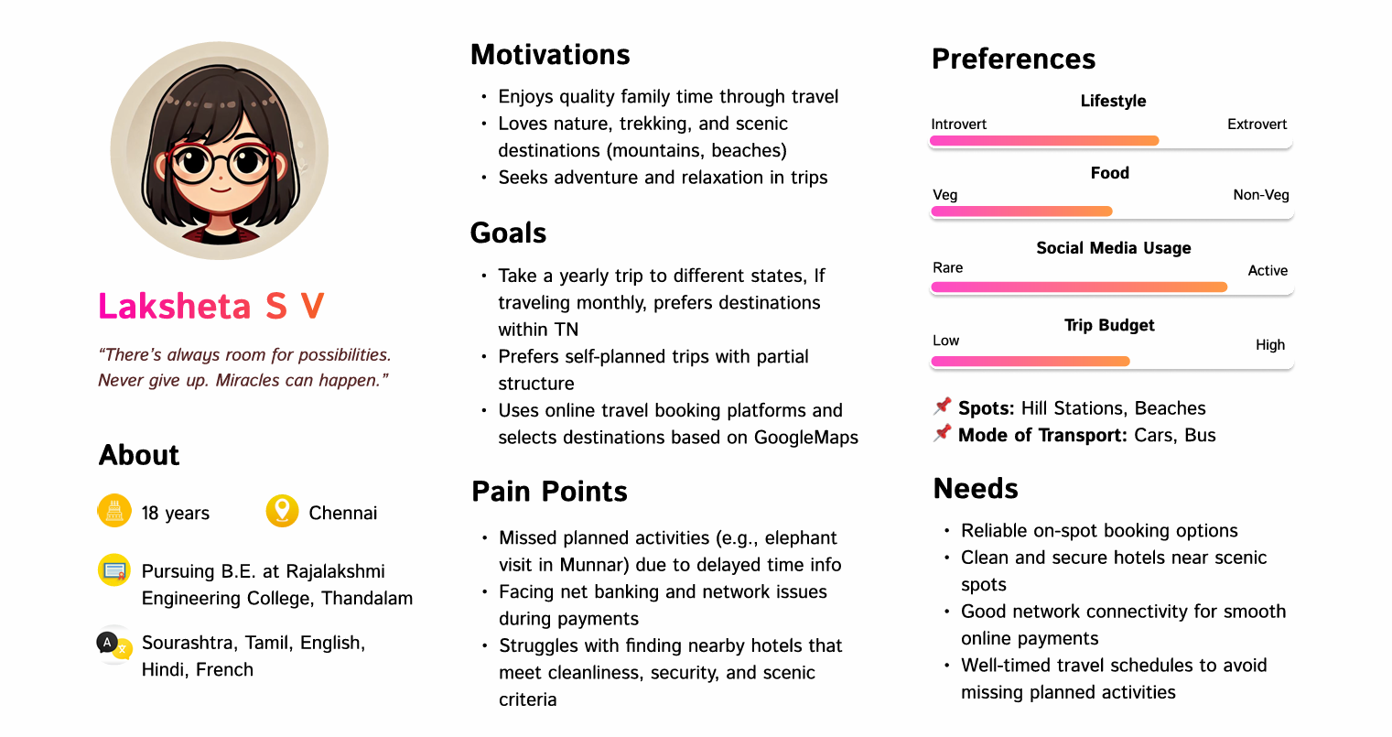
PERSONA

Slide 7

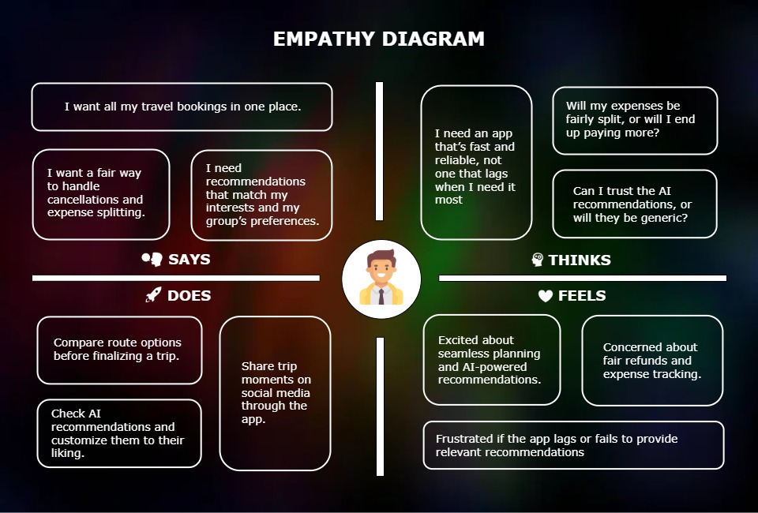

Slide 8
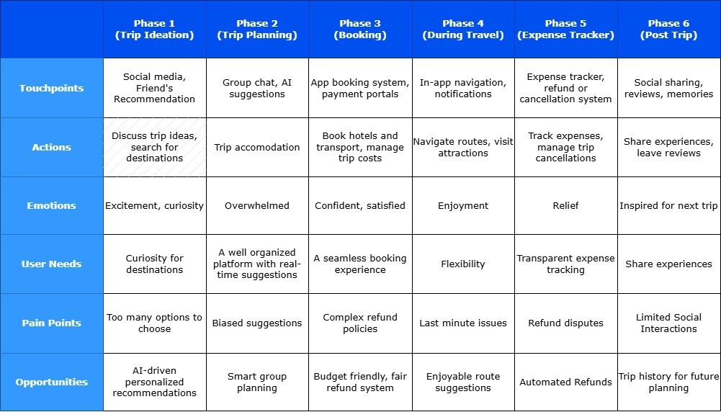
JOURNEY MAP

Slide 9


